Slide 1

Hackathon #3 - Time Series Forecasting
September 27th, 2020

Slide 2
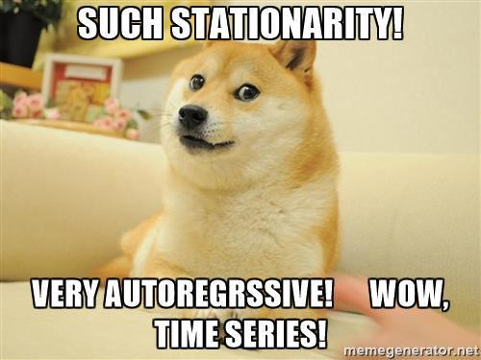
Our prediction is to infinity and beyond!
Manuel Gonçalves
Ricardo Almeida
Sonia Allaei

Slide 3
1. Problem description

Slide 4
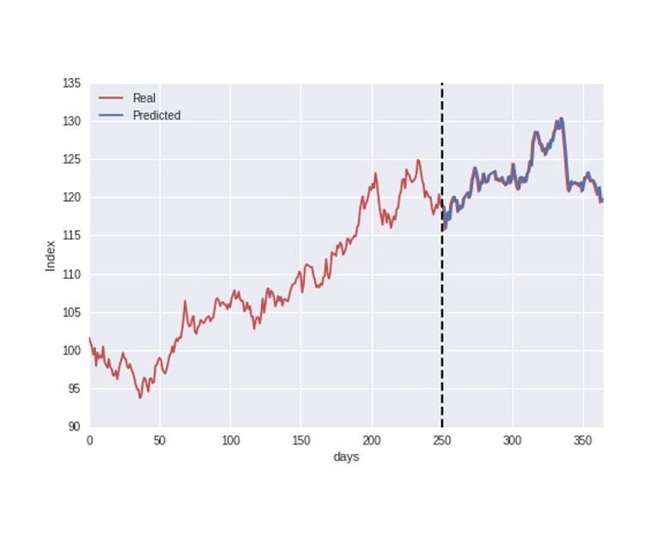
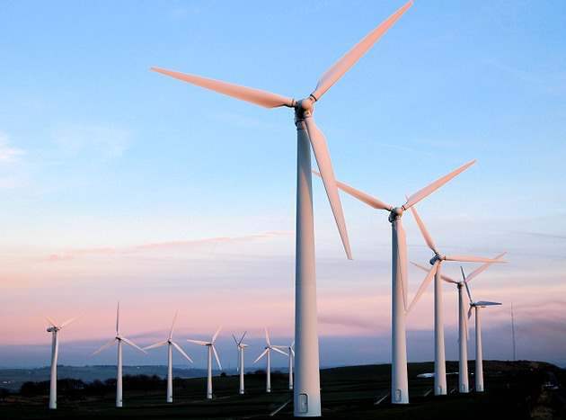
Problem description
‘Forecast wind power generation for the next day in 3 wind farms.’

Slide 5
2. Workflow

Slide 6
2.1 Data preparation

Slide 7
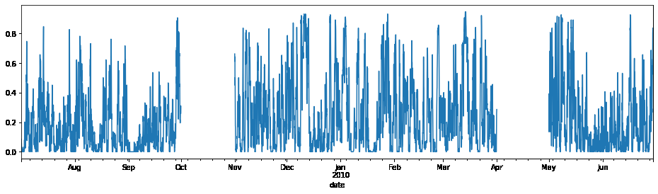
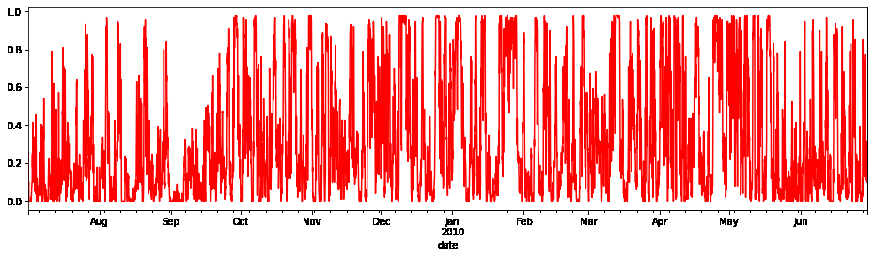
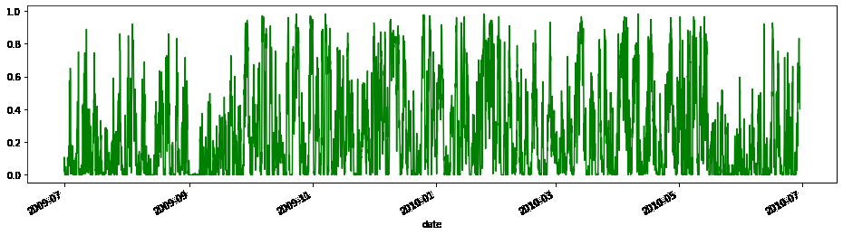
Initial Data

Slide 8
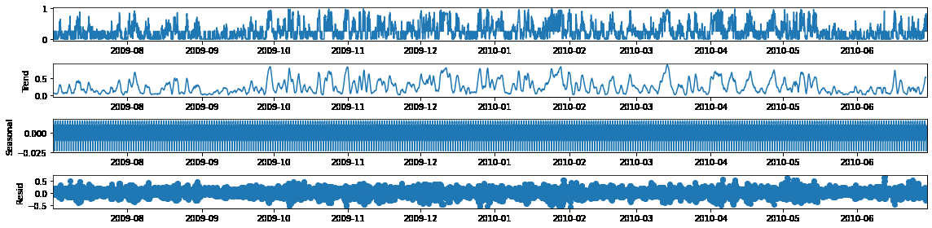
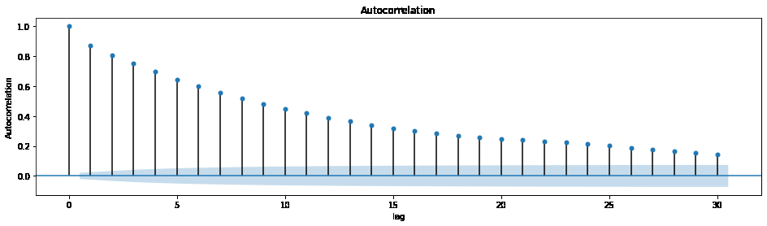
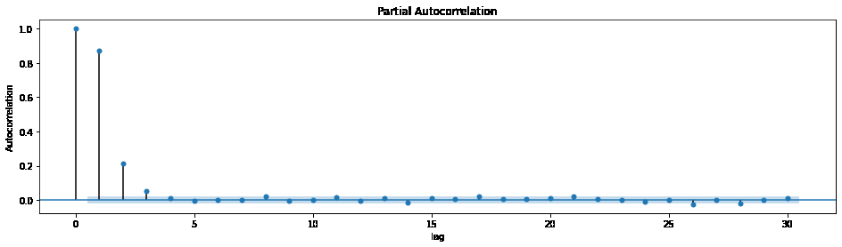
Initial Data

Slide 9
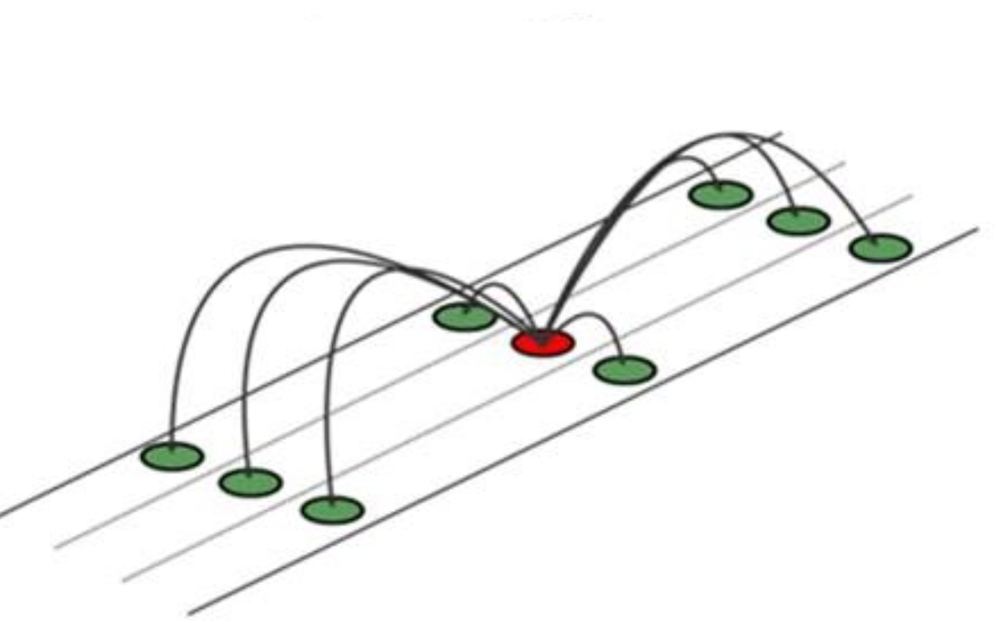
Handling data problems
KNN Imputer
Resample

Slide 10
2.2 Model selection

Slide 11
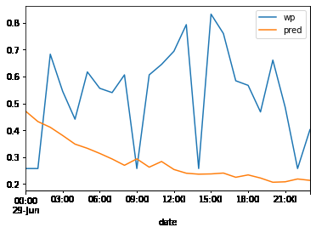
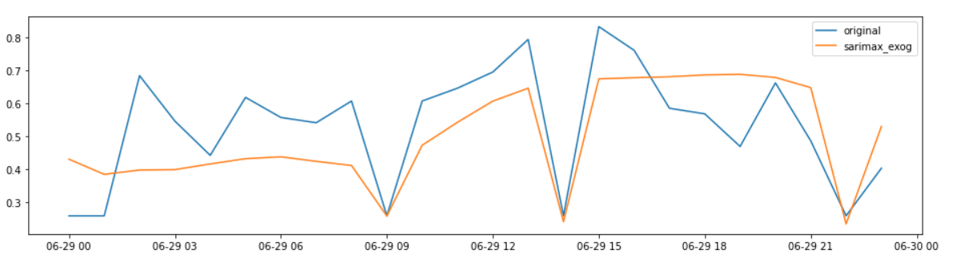
First Attempt
Using SARIMAX with pmdarima
Using Machine Learning Model

Slide 12
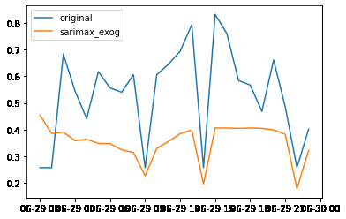
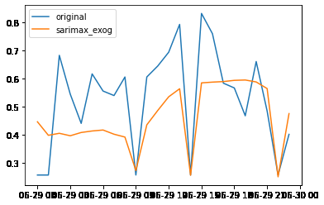
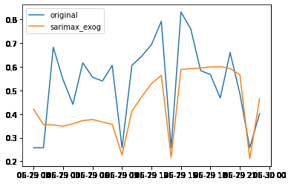
Second Attempt
The idea - Maybe we don’t need a year of information to predict a single day!
Using the previous month of information - 1st baseline Subm.
Using the 2 previous month of information
Using the 3 previous month of information - 2nd Subm.

Slide 13
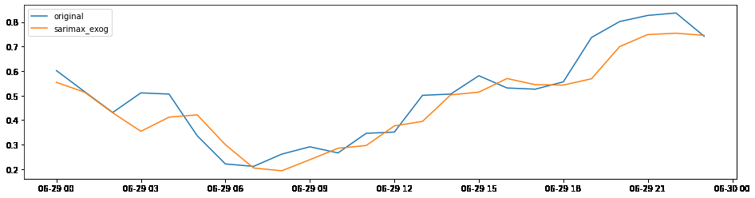
Third Attempt
1 year of data + 3 periods lagged + Month as feature + Hour as feature + Sarimax on pmdarima = 4th Subm.

Slide 14
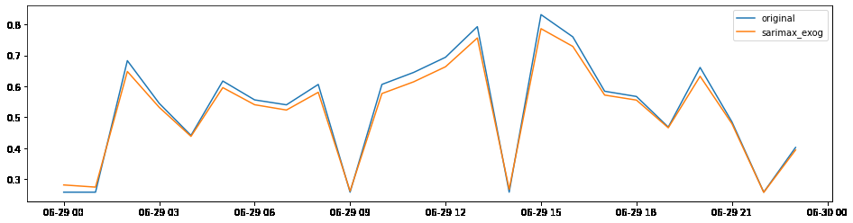
Fourth Attempt
1 year of data + 24 periods lagged + Month as feature + Hour as feature + Weekday as feature + Sarimax on pmdarima = 5th Subm.

Slide 15
3. Future Work

Slide 16
Future work
Features
Models
Tunning

Slide 17
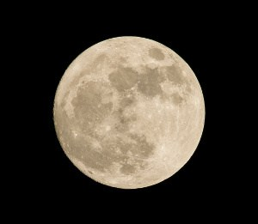
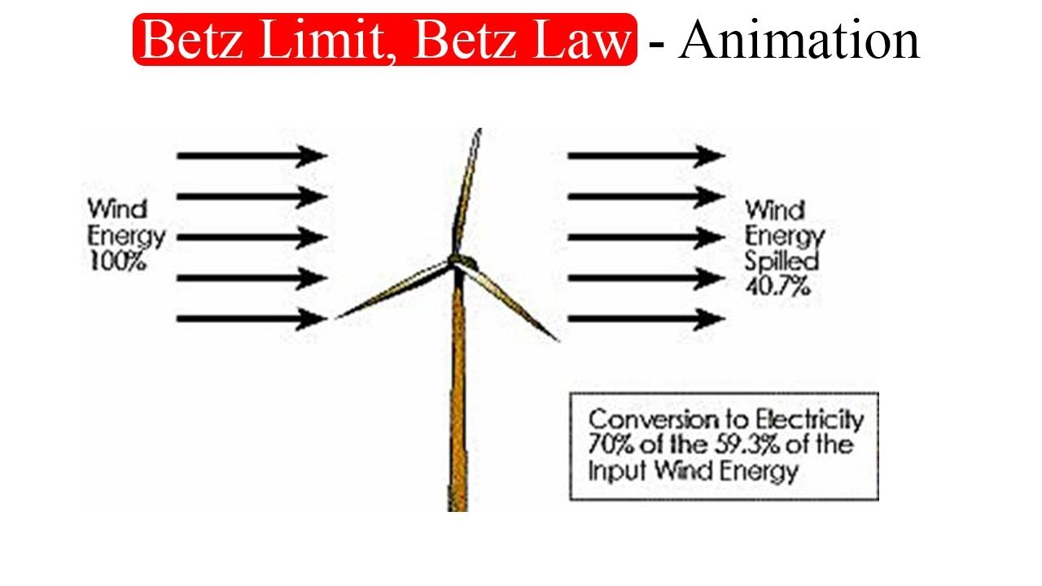
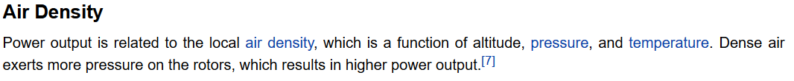
Future Ideas
Can the moon cycle influence wind Power??
Wind Speed +
Wind Power Upper Limit
Source: https://energyeducation.ca/encyclopedia/Wind_power

Slide 18
The End!

Slide 19
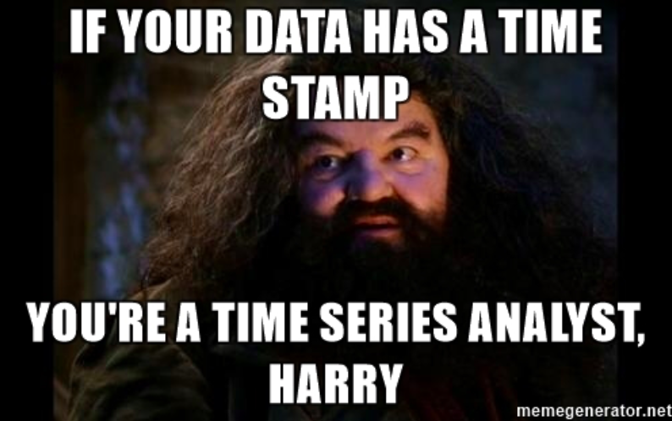
The End

